Slide 1
Evolutionary Algorithms for Solving Single-objective Constrained Optimization Problems
（单目标约束优化问题）
Yong Wang
School of Automation
Central South University
ywang@csu.edu.cn
https://intleo.csu.edu.cn/

Slide 2
Outline of My Talk
Single-objective Constrained Optimization Problems
Solving Single-objective Constrained Optimization Problems by Evolutionary Algorithms
Constraint-handling Techniques
Our Main Work
Conclusion

Slide 3
Outline of My Talk
Single-objective Constrained Optimization Problems
Solving Single-objective Constrained Optimization Problems by Evolutionary Algorithms
Constraint-handling Techniques
Our Main Work
Conclusion

Slide 4

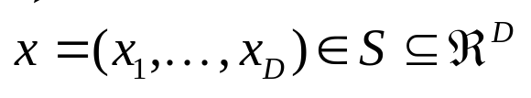





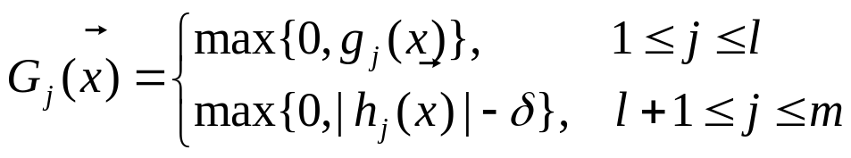
Single-objective Constrained Optimization Problems (1/5)
The single-objective constrained optimization problems (SCOPs，单目标约束优化问题) can be formulated as follows:
minimize
subject to
The degree（程度） of constraint violation（约束违反） of an individual on the jth constraint is defined as:
inequality constraints
（不等式约束条件）
equality constraints
（等式约束条件）
a positive tolerance value for equality constraints

Slide 5
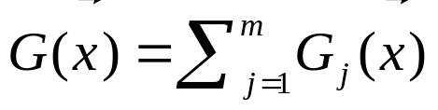

Single-objective Constrained Optimization Problems (2/5)
The degree of constraint violation of on all the constraints:
Based on the degree of constraint violation, the feasible region（可行域） is defined as follows:

Slide 6
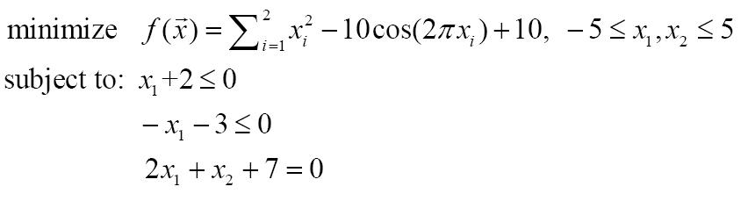
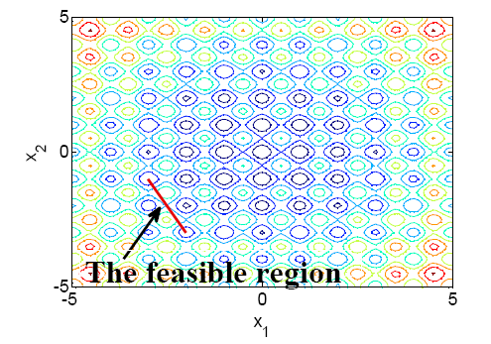
Single-objective Constrained Optimization Problems (3/5)
Three examples - I

Slide 7
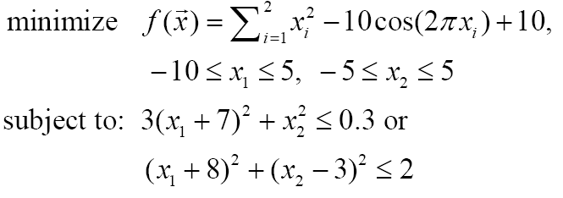
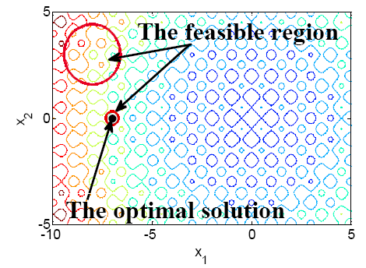
Single-objective Constrained Optimization Problems (4/5)
Three examples - II

Slide 8
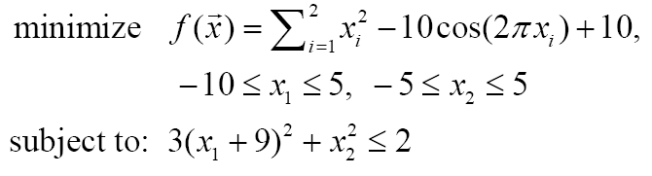
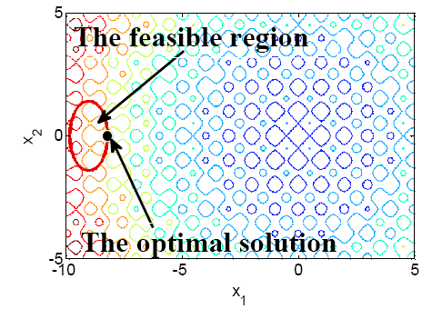
Single-objective Constrained Optimization Problems (5/5)
Three examples - III

Slide 9
Outline of My Talk
Single-objective Constrained Optimization Problems
Solving Single-objective Constrained Optimization Problems by Evolutionary Algorithms
Constraint-handling Techniques
Our Main Work
Conclusion

Slide 10
Solving SCOPs by EAs (1/4)
In the field of evolutionary computation, there has been a growing interest in applying evolutionary algorithms (EAs) to solve SCOPs.
Due to the presence of constraints, many constraint-handling techniques（约束处理技术） have been suggested and integrated with EAs, and as a result, a variety of constrained optimization EAs (COEAs，约束优化进化算法) have been proposed
Remark: the purposes of solving SCOPs by EAs
1) Approach（靠近） the feasible region promptly（迅速地）
2) Find the optimal solution in the end

Slide 11
Solving SCOPs by EAs (2/4)
COEAs
=
EAs
+
Constraint-handling techniques
Search the optimal solution
determine the criterion（准则） to compare the individuals in the parent and offspring populations（父代和子代群体）
The optimal solution
the infeasible region
the feasible region

Slide 12
Solving SCOPs by EAs (3/4)
EAs
COEAs
SCOPs
A contradiction（矛盾）
Some infeasible solutions may carry more important information for finding the feasible optimal solution
To find the feasible optimal solution
Objective function
Determinate the tradeoff（平衡） between them
Constraint violation

Slide 13
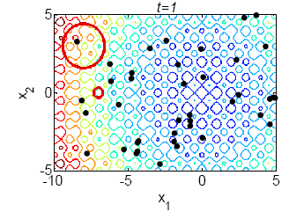
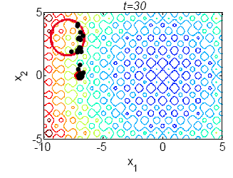
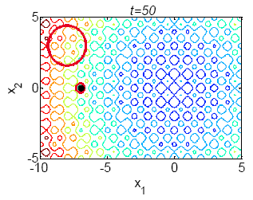
Solving SCOPs by EAs (4/4)
Optimization process（优化过程）

Slide 14
Outline of My Talk
Single-objective Constrained Optimization Problems
Solving Single-objective Constrained Optimization Problems by Evolutionary Algorithms
Constraint-handling Techniques（约束处理技术）
Our Main Work
Conclusion

Slide 15


Constraint-handling Techniques (1/6)
  The main aim of constraint-handling techniques is to determine the criterion（准则） to compare the individuals in the parent and offspring populations.
  The core of constraint-handling techniques is to make a tradeoff（平衡） between objective function and constraint violation
Objective
Function
Constraint
Violation

Slide 16
Constraint-handling Techniques (2/6)
There are three main kinds of constraint-handling techniques
  Methods based on penalty functions（惩罚函数法）
  Methods based on preference of feasible solutions over infeasible solutions（可行解偏好于不可行解法）
  Methods based on multiobjective optimization（多目标优化法）

Slide 17
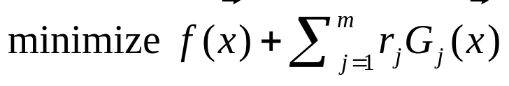
Constraint-handling Techniques (3/6)
Methods based on penalty functions（惩罚函数法）
penalty factors（惩罚因子）
penalty term（惩罚项）
  Drawback: penalty factors are problem-dependent（依赖于问题）!
S. B. Hamida and M. Schoenauer, “ASCHEA: New results using adaptive segregational constraint handling,” in Proc. CEC, 2002, pp. 884-889.
D. W. Coit, A. E. Smith, and D. M. Tate, “Adaptive penalty methods for genetic optimization of constrained combinatorial problems,” Inf. J. Comput., vol. 8, no. 2, pp. 173-182, 1996.
R. Farmani and J. A. Wright, “Self-adaptive fitness formulation for constrained optimization,” IEEE Trans. Evol. Comput., vol. 7, no. 5, pp. 445-455, 2003.
B. Tessema and G. G. Yen, “An adaptive penalty formulation for constrained evolutionary optimization,” IEEE Trans. Syst., Man, Cybern. A, Syst., Humans, vol. 39, no. 3, pp. 565–578, 2009.

Slide 18


Constraint-handling Techniques (4/6)
Methods based on preference of feasible solutions over infeasible solutions（可行解偏好于不可行解法）
  The comparison of individuals is based on either or
  Feasible solutions are always considered to be better than infeasible ones to a certain degree.
  Drawback: ignore（忽略） the important information of infeasible solutions!
K. Deb, “An efficient constraint handling method for genetic algorithms,” Comput. Methods Appl. Mech. Eng., vol. 186, no. 2-4, pp. 311-338, 2000.
E. Mezura-Montes and C. A. Coello Coello, “A simple multimembered evolution strategy to solve constrained optimization problems,” IEEE Trans. Evol. Comput., vol. 9, no. 1, pp. 1-17, 2005.
T. Takahama and S. Sakai, “Constrained optimization by applying the α constrained method to the nonlinear simplex method with mutations,” IEEE Trans. Evol. Comput., vol. 9, no. 5, pp. 437-451, 2005.
T. Takahama and S. Sakai, “Constrained optimization by ε constrained differential evolution with dynamic ε-level control,” in Advances in Differential Evolution, U. K. Chakraborty, Ed. Berlin, Germany: Springer, 2008, pp. 139-154.
T. P. Runarsson and X. Yao, “Stochastic ranking for constrained evolutionary optimization,” IEEE Trans. Evol. Comput., vol. 4, no. 3, pp. 284-294, 2000.

Slide 19
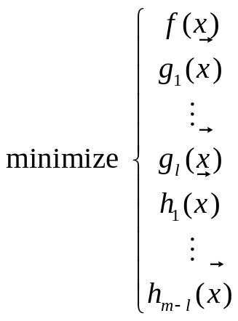
Constraint-handling Techniques (5/6)
Methods based on multiobjective optimization（多目标优化法）
  Each constraint is considered as an objective function
Drawback: suffer from（遭受） the curse of dimensionality（维数灾难） with the drastic increase（显著增加） of constraints!
C. A. Coello Coello, “Treating constraints as objectives for single-objective evolutionary optimization,” Eng. Opt., vol. 32, no. 3, pp. 275-308, 2000.
C. A. Coello Coello, “Constraint handling using an evolutionary multiobjective optimization technique,” Civil Eng. Environ. Syst., vol. 17, no. 4, pp. 319-346, 2000.
C. A. Coello Coello and E. Mezura-Montes, “Constraint-handling in genetic algorithms through the use of dominance-based tournament selection,” Adv. Eng. Informatics, vol, 16, no. 3, pp. 193-203, 2002.
T. Ray and K. M. Liew, “Society and civilization: An optimization algorithm based on the simulation of social behavior,” IEEE Trans. Evol. Comput., vol. 7, no. 4, pp. 386-396, 2003.

Slide 20
Constraint-handling Techniques (6/6)
More details（细节） are presented by
  Z. Michalewicz and M. Schoenauer, “Evolutionary algorithm for constrained parameter optimization problems,” Evol. Comput., vol. 4, no. 1, pp. 1-32, 1996.
  C. A. Coello Coello, “Theoretical and numerical constraint-handling techniques used with evolutionary algorithms: a survey of the state of the art,” Comput. Meth. Appl. Mech. Eng., vol. 191, no. 11-12, pp. 1245-1287, 2002.
  E. Mezura-Montes and C. A. Coello Coello, “Constraint-handling in natureinspired numerical optimization: Past, present and future,” Swarm Evol. Comput., vol. 1, no. 4, pp. 173-194, 2011.
  王冰川, 王勇. 进化算法求解约束优化问题研究进展. 中国人工智能学会通讯, 2016, 6(9): 41-50.

Slide 21


An Analysis on Penalty Functions (1/6)
Introduce a penalty term（惩罚项） into the objective function
Fitness function
A
penalty term
A’
constrained
optimization
problem
unconstrained
optimization
problem
There has been some work on the dynamic setting（动态设置） of values in evolutionary constrained optimization:
Monotonically nondecreasing sequence（单调非减序列）
An adaptive approach（自适应方法）
T. P. Runarsson and X. Yao, “Stochastic ranking for constrained evolutionary optimization,” IEEE Trans. Evol. Comput., vol. 4, no. 3, pp. 284-294, 2000.

Slide 22



An Analysis on Penalty Functions (2/6)
f
the search space
Feasible region
0
G
when is too small: an infeasible solution be evolved by an EA
when is too large: easy to find a feasible solution, but poor quality

Slide 23




An Analysis on Penalty Functions (3/6)
1. Rank（排序） the λ individuals
2. Examine the adjacent pair（相邻对） i and i+1 in the ranked order
Critical penalty coefficient（至关重要的惩罚系数）
Generated from 1 and 2

Slide 24

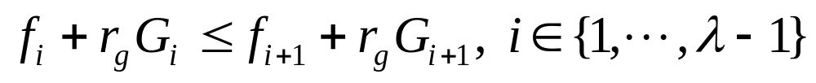









An Analysis on Penalty Functions (4/6)
For , there are three different cases
 |  | dominated（支配） by the objective function
 |  | dominated（支配） by the penalty function
 |  | nondominated（非支配）
When two individuals are feasible（可行）,
Remark 1: When comparing nondominated and feasible individuals, the value of r_{g} has no impact on the inequality
Remark 2: For the entire population, the chosen value of r_{g} used for comparisons will determine the fraction of individuals dominated by the objective and penalty functions.

Slide 25
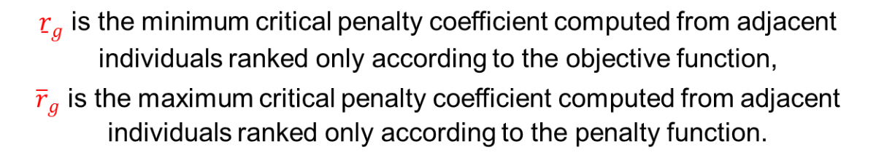



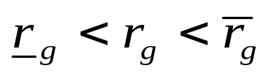
An Analysis on Penalty Functions (5/6)
: All comparisons are based only on the objective function. We will call this underpenalization（欠惩罚）.
: All comparisons are based only on the penalty function. We will call this overpenalization（过惩罚）.
: All comparisons are based on a combination（组合） of objective and penalty functions.
It has been widely recognized that neither under- nor over-penalization
is a good constraint-handling technique.
So:

Slide 26


An Analysis on Penalty Functions (6/6)
lt is worth noting（值得注意的是） that and are not fixed.
They are problem dependent（依赖于问题）, and may change from generation to generation（每代都发生变化） as they are also determined by the current population（当前的群体）.

Slide 27
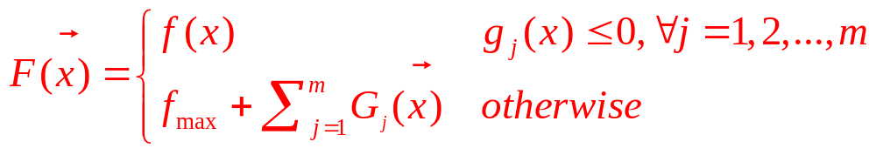
The Feasibility Rule（可行性准则，三条比较准则）
the objective function value of the worst feasible solution in the population
1) Between two infeasible solutions, the one with smaller degree of constraint violation is preferred（偏好）.
2) If one solution is infeasible and the other one is feasible, the feasible solution is preferred（偏好）.
3) Between two feasible solutions, the one with better objective function value is preferred（偏好）.
K. Deb, “An efficient constraint handling method for genetic algorithms,” Comput. Methods Appl. Mech. Eng., vol. 186, no. 2-4, pp. 311-338, 2000.

Slide 28
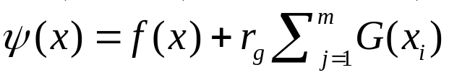
Stochastic Ranking (1/3，随机排序)
According to
Ranking individuals in
a population adaptively
Rank-based selection can be used
How to rank individuals according to their
objective and penalty value
New constraint-handling technique
Stochastic ranking
T. P. Runarsson and X. Yao, “Stochastic ranking for constrained evolutionary optimization,” IEEE Trans. Evol. Comput., vol. 4, no. 3, pp. 284-294, 2000.

Slide 29












Stochastic Ranking (2/3)
Use a probability parameter P_{f}
Stochastic ranking (SR)
Choose pair-wise adjacent individuals
Feasible region
Objective function of
better
wins
Objective function of
wins
better
Use a uniformly generated random number between
0 and 1
Objective function of
else
Constraint violations of
less
wins

Slide 30
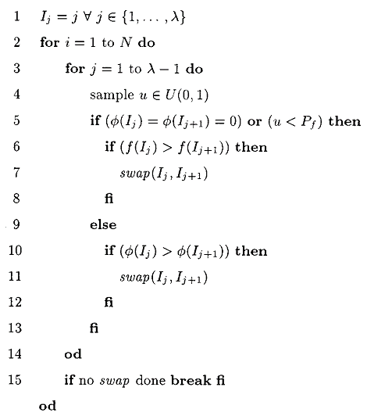
Stochastic Ranking (3/3)
G
G
G
G

Slide 31
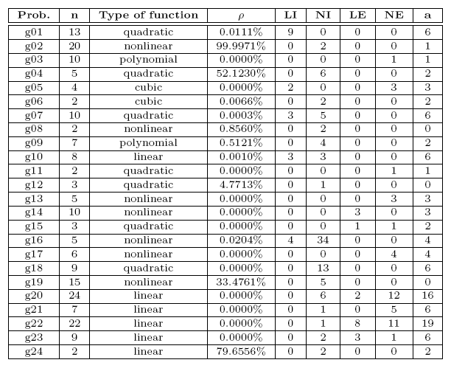
Benchmark test functions (2/2)
The characteristics of 24 benchmark test functions（标准测试函数） for constrained optimization

Slide 32
Outline of My Talk
Single-objective Constrained Optimization Problems
Solving Single-objective Constrained Optimization Problems by Evolutionary Algorithms
Constraint-handling Techniques
Our Main Work
Conclusion

Slide 33
Our Main Work
We have developed several methods
  CW and CMODE
  HCOEA and DyHF
  ATM and (μ+λ)-CDE
  FROFI

Slide 34
Our Main Work
We have developed several methods
  CW and CMODE
  HCOEA and DyHF
  ATM and (μ+λ)-CDE
  FROFI

Slide 35
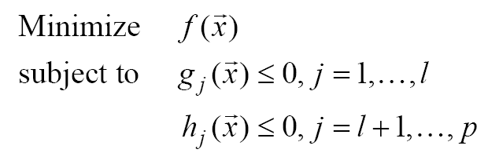
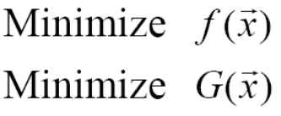

CW (1/5)
Motivation（动机）
  The current constraint-handling techniques usually employ a biased（偏见的） comparison criterion
  Pareto dominance（帕累托支配） is an unbiased comparison criterion
The main idea
Multiobjective optimization techniques can be used to solve
the transformed biobjective（双目标） optimization problem
Z. Cai and Y. Wang*, “A multiobjective optimization-based evolutionary algorithm for constrained optimization.” IEEE Transactions on Evolutionary Computation, vol. 10, no. 6, pp. 658-675, 2006.

Slide 36

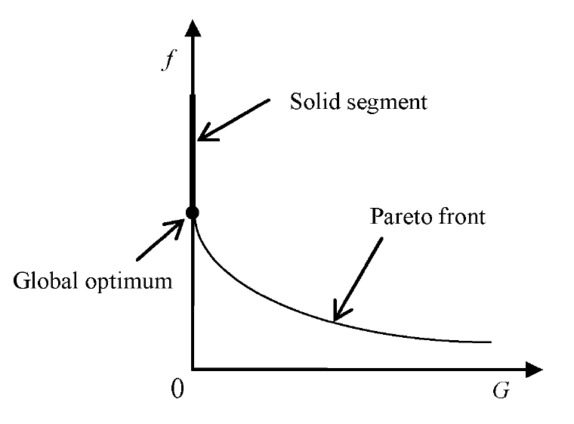

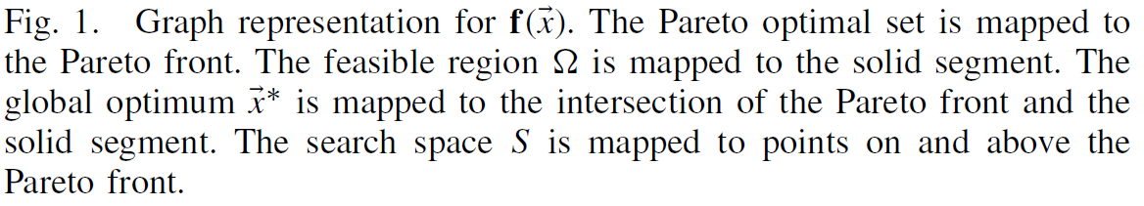
CW (2/5)
The difference between and the general multiobjective optimization problems（多目标优化问题）
  will retrogress（退化） into a single-objective optimization problem within the feasible region (because in this case )

Slide 37
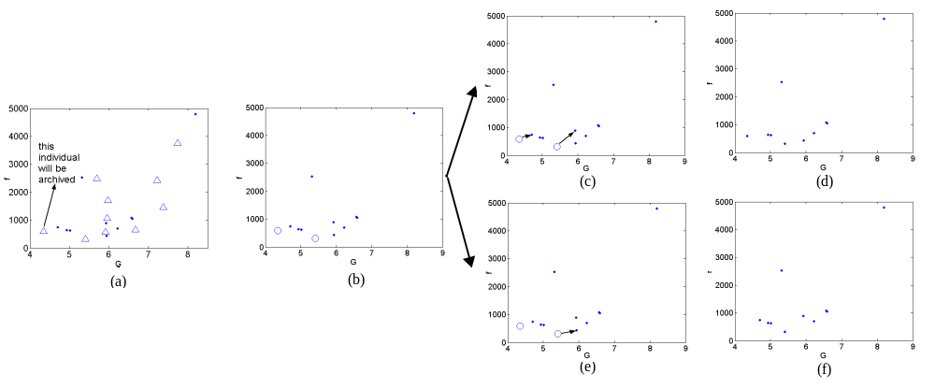
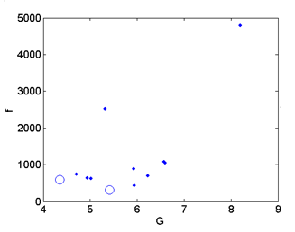


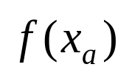
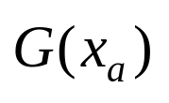
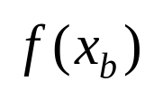
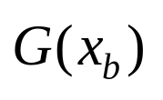
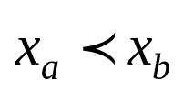
CW (3/5)
Pareto dominates（帕累托支配）
≤
≤
Pareto dominate
<
“ . ” denotes the parent
“Δ” denotes the offspring
“o” denotes the nondominated individual（非劣个体） in the offspring population
Updating of the population in one iteration（一次迭代）

Slide 38
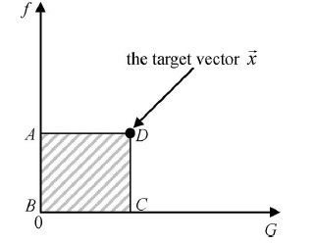

CW (4/5)
The motivation of archiving and replacement（存档和替换）
Archiving and Replacement
an individual
The inefficiency of Pareto dominance: only the individuals in the region ABCDA can Pareto dominate ; thus, replacement may occur occasionally（很少发生） and the selection pressure（选择压） is very low
randomly replace（随机替换）
pop
store
The infeasible solution with the lowest degree of constraint violation at each generation
Arc

Slide 39
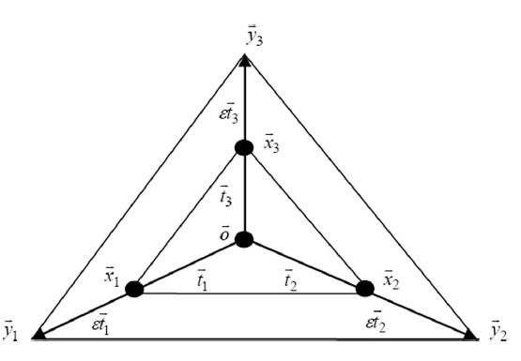
CW (5/5)
Recombination (simplex crossover, SPX，单形交叉)
  N+1 individuals form a simplex in a n-dimensional search space
  Expand the old simplex to get a new simplex
  Randomly generate an individual from the new simplex
Three-parent SPX in a 2-D space

Slide 40
CMODE (1/4)
Motivation
  CW includes some problem-dependent control parameters, such as the expanding factor（膨胀因子） in the simplex crossover
The main idea
  Use differential evolution (DE) to generate new solutions
  A novel infeasible solution replacement mechanism
Y. Wang and Z. Cai, “Combining multiobjective optimization with differential evolution to solve constrained optimization problems,” IEEE Transactions on Evolutionary Computation, vol. 16, no. 1, pp. 117-134, 2012.
-<number>-

Slide 41
CMODE (2/4)
The infeasible solution replacement mechanism
  The infeasible solution with the lowest degree of constraint violation at each generation is stored into an archive
pop
the worst individuals in terms of convergence and feasibility
pop
Arc
Arc
the deterministic replacement
（确定性替换）
  the random replacement
  （随机替换）
Aim: enhance the quality（质量） and feasibility（可行性） of the population simultaneously
Aim: enhance the feasibility（可行性） and diversity（多样性） of the population simultaneously

Slide 42




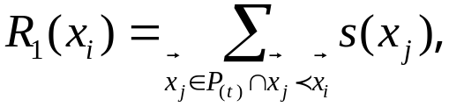


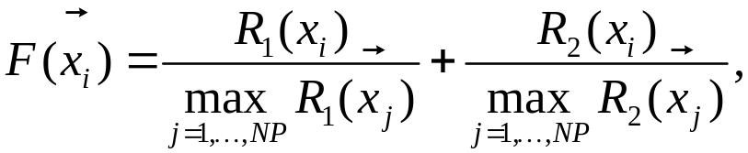

CMODE (3/4)
The deterministic replacement
  The strength value（强度值）
  The rank value
  The rank value based on the degree of constraint violations
  The final fitness function
based on Pareto dominance
convergence
feasibility
-<number>-

Slide 43

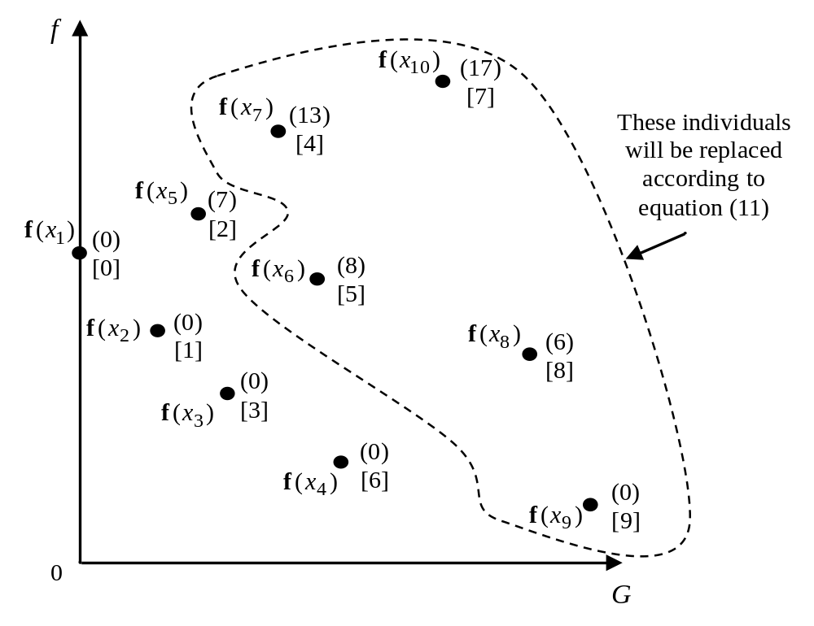
CMODE (4/4)
An example of the deterministic replacement
():
[]:
these five individuals will be replaced
-<number>-

Slide 44
Our Main Work
We have developed several methods
  CW and CMODE
  HCOEA and DyHF
  ATM and (μ+λ)-CDE
  FROFI

Slide 45
HCOEA (1/5)
Motivation
  COEAs can be generalized as constraint-handling techniques plus EAs, i.e., a proper constraint-handling technique needs to be considered in conjunction with an appropriate search algorithm
The main idea
  HCOEA adopts multiobjective optimization techniques to handle constraints
  HCOEA combines the global and local search models
Y. Wang, Z. Cai, G. Guo, and Y. Zhou, “Multiobjective optimization and hybrid evolutionary algorithm to solve constrained optimization problems.” IEEE Transactions on Systems, Man and Cybernetics, Part B: Cybernetics, vol. 37, no. 3, pp. 560-575, 2007.

Slide 46
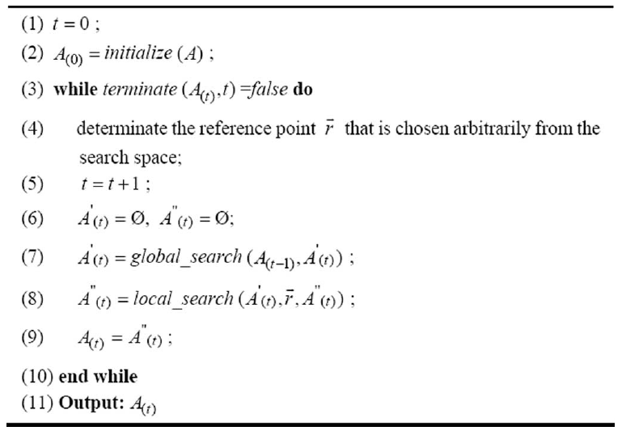
HCOEA (2/5)
Main Framework

Slide 47
HCOEA (3/5)
The global search model
  First, the population of size N is mated into N/2 pairs of couples at random.
  Pairwise individuals are then sequentially chosen and used to produce pairwise offspring through crossover and mutation operations.
  If the offspring Pareto dominates the similar parent, then it replaces the similar parent.
The global search model is
a niching genetic algorithm

Slide 48
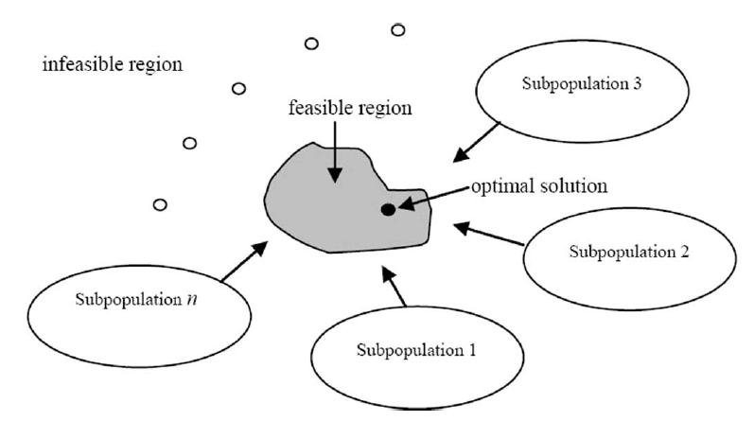
HCOEA (4/5)
The local search model
Schematic diagram to illustrate the local search model

Slide 49
HCOEA (5/5)
The implementation of the local search model
a parent
an offspring
one subpopulation
the best infeasible individual
f
f
population
G
G
Pareto dominate
randomly replace

Slide 50
DyHF (1/5)
Motivation
  At different stages of evolution, different probabilities for the local and global search may be required to achieve the best performance.
The main Idea
  Make use of differential evolution (DE) to generate the offspring population during both the global and local search models
  Dynamically implement the global and local search models
Y. Wang and Z. Cai. “A dynamic hybrid framework for constrained evolutionary optimization,” IEEE Transactions on Systems, Man and Cybernetics, Part B: Cybernetics, vol. 42, no. 1, pp. 203-217, 2012.

Slide 51
DyHF (2/5)
Dynamically implement the global and local search models
If rand<NF/NP // rand is a uniformly distributed random number between 0 and 1, NF denotes the number of feasible solutions, and NF/NP is the feasibility proportion of the current population
Implement the global search model
Else
Implement the local search model
End If
The global and local search models are dynamically applied by
tracking the feasibility proportion (i.e., NF/NP) of the current population

Slide 52
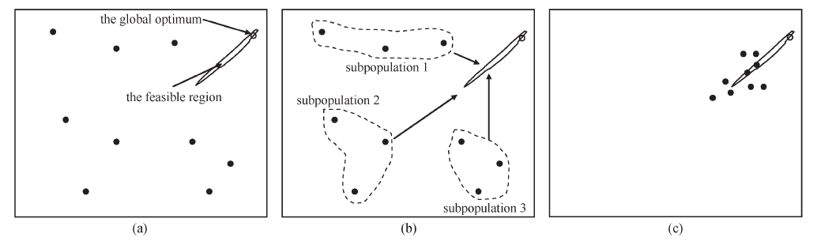
DyHF (3/5)
An analysis
  In the early stage, the feasibility proportion of the population may be very small or equal to zero. In this case, the local search model is performed with a higher frequency to guide the population toward feasibility promptly.

Slide 53
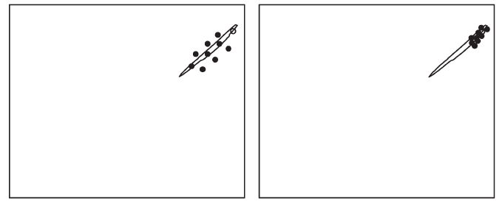
DyHF (4/5)
An analysis
  Along with the evolution, the population may converge near the feasible region, and some individuals of the population may be feasible. Thus, the global search is gradually strengthened to encourage the individuals to probe more promising region (especially to probe the feasible region).

Slide 54
DyHF (5/5)
An analysis
  At the later stage of search, most of the individuals of the population may be feasible. Thus, the local search model is executed with a less probability, and the global search model is mainly used to refine the overall quality of the population.
Hence, the above dynamic implementation of the global and local search models can switch smoothly from feasibility to convergence

Slide 55
Our Main Work
We have developed several methods
  CW and CMODE
  HCOEA and DyHF
  ATM and (μ+λ)-CDE
  FROFI

Slide 56
ATM (1/10)
Motivation
  During the evolutionary process, the population may inevitably experience the following three situations:
    The infeasible situation: the population contains only infeasible solutions
    The semi-feasible situation: the population consists of a combination of feasible and infeasible solutions
    The feasible situation: the population is entirely composed of feasible solutions
The main idea
  ATM (Adaptive Tradeoff Model) designs one tradeoff strategy for one situation (divide and conquer)
Y. Wang, Z. Cai, Y. Zhou and W. Zeng, “An adaptive tradeoff model for constrained evolutionary optimization,” IEEE Transactions on Evolutionary Computation, vol. 12, no. 1, pp. 80-93, 2008.

Slide 57
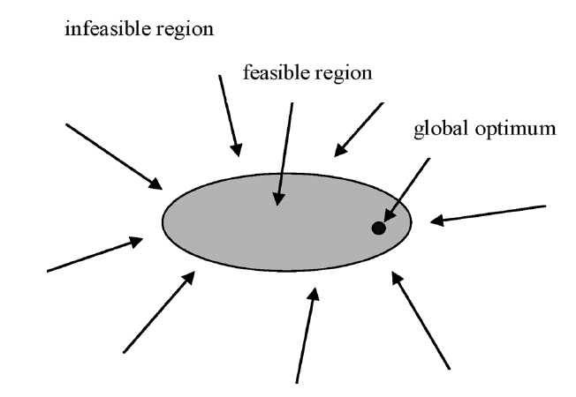
ATM (2/10)
The tradeoff for the infeasible situation

Slide 58
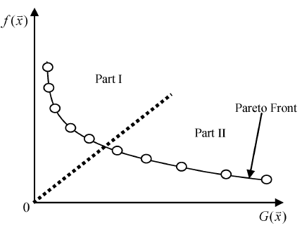
ATM (3/10)
The tradeoff for the infeasible situation
  Nondominated individuals represent the Pareto optimal set of the population
  Hierarchical nondominated sorting
    Rank nondominated individuals based on their constraint violations in ascending order
    Select only the first half of nondominated individuals and store them into the offspring population

Slide 59
ATM (4/10)
The tradeoff for the infeasible situation
f
The current population
The offspring population
0
G
hierarchical nondominated sorting

Slide 60
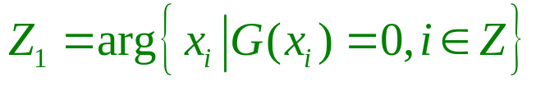
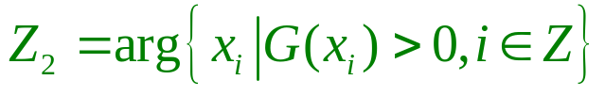
ATM (5/10)
The tradeoff for the semi-feasible situation
The second tradeoff is proposed to retain some important feasible and infeasible solutions in the population simultaneously
The goal of COEAs is to find the feasible optimal solution
Some infeasible solutions may carry important information to bias the search
Some related definitions
A population with λ individuals are recorded into a set Z, i.e., Z={1,2,. . ., λ} .Then the population is divided into the feasible group Z₁ and the infeasible group Z₂ , according to the feasibility of each individual

Slide 61
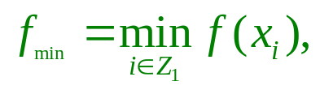
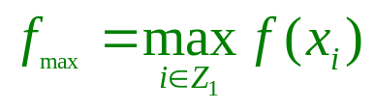

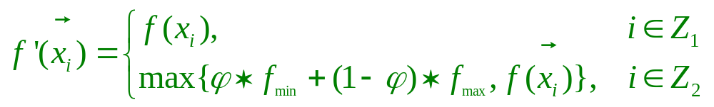

ATM (6/10)
The tradeoff for the semi-feasible situation
  The best and worst feasible solutions are found by the following form:
  The converted objective function is as follows
  where denotes the feasibility proportion of the last population.
Note that only the objective function of infeasible individuals is altered after conversion

Slide 62
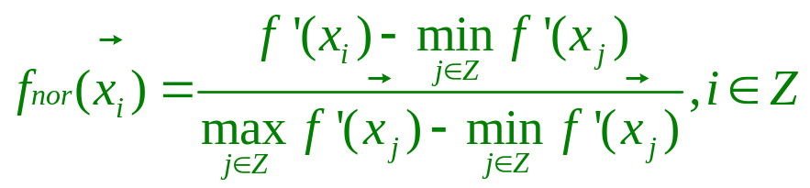
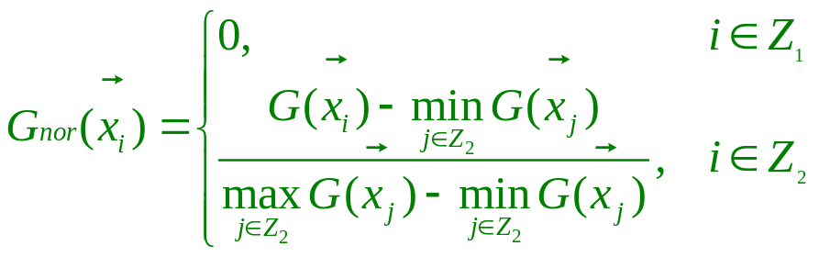
ATM (7/10)
The tradeoff for the semi-feasible situation
  Each objective function value is then normalized
  The constraint violations can be normalized according to
Remark 1: the normalization of objective function value is based on both the feasible and infeasible groups.
Remark 2: the normalized constraint violations of infeasible individuals are based only on the maximum and minimum constraint violations in the infeasible group

Slide 63









ATM (8/10)
The tradeoff for the semi-feasible situation
The second tradeoff is capable of adapting the rank of feasible and infeasible solutions by making use of the information obtained from the last population
We can see that
The second tradeoff has the capability to adaptively convert the fitness of individuals based on the feasibility proportion of the last population

Slide 64


ATM (9/10)
Property 1
Comparison rules
Feasible solution
Feasible solution
Feasible solution
Infeasible solution
Objective function values
Comparison
Property 2
The effect of parameter
Objective function values
Constraint violations
Infeasible solution
Objective function values are smaller
larger
Property 3
Some infeasible individuals are better than feasible solutions
The probability to survive into the next population
Infeasible
individuals
higher
lower
Objective function values are larger
smaller
The best feasible individual also has the minimum fitness
Property 4

Slide 65


ATM (10/10)
The tradeoff for the feasible situation
The feasible situation
Unconstrained optimization
0
The comparisons of individuals are based only on their objective function values

Slide 66
(μ+λ)-CDE (1/5)
Motivation
  ATM uses a simple (μ,λ)-ES as the search engine
The main idea
  (μ+λ)-DE is adopted as the search engine
  An improved ATM serves as the constraint-handling technique
Y. Wang and Z. Cai, “Constrained evolutionary optimization by means of (μ+λ)-differential evolution and improved adaptive trade-off model.” Evolutionary Computation, vol. 19, no. 2, pp. 249-285, 2011.

Slide 67


(μ+λ)-CDE (2/5)
(μ+λ)-DE
μ parents
μ individuals
with higher
quality
λ offspring

Slide 68




(μ+λ)-CDE (3/5)
We employ two criteria to compute the degree of constraint violation of an individual
  The measures for the different constraint violations may have largely different scales
  The differences among the constraints may not be significant

Slide 69
(μ+λ)-CDE (4/5)
Improved ATM: the infeasible situation
the best (μ+ λ)/2 individuals based on constraint violations
P_{t+1}
P_{t} : μ parents
P_{temp}
randomly selected
Q_{t} : λ offspring

Slide 70

(μ+λ)-CDE (5/5)
Improved ATM: the semi-feasible situation
  The same with ATM except that the final fitness function is obtained by the following equation:
Improved ATM: the feasible situation
  The same with ATM

Slide 71
Our Main Work
We have developed several methods
  CW and CMODE
  HCOEA and DyHF
  ATM and (μ+λ)-CDE
  FROFI

Slide 72
FROFI (1/6)
The feasibility rule
  Any feasible solution is preferred to any infeasible solution
  Among two feasible solutions, the one that has a better objective function value is preferred
  Among two infeasible solutions, the one that has a smaller degree of constraint violation is preferred
K. Deb, “An efficient constraint handling method for genetic algorithms,” Computer Methods in Applied Mechanics and Engineering, vol. 186, no. 2-4, pp. 311-338, 2000.

Slide 73

FROFI (2/6)
Motivation
  In the feasibility rule, too many emphases have been put on the constraints
The main idea
  Incorporating objective function information into both the feasibility rule and the search algorithm
The information of objective function should be exploited!!!
Y. Wang, B.-C. Wang, H.-X. Li, and G. G. Yen. Incorporating objective function information into the feasibility rule for constrained evolutionary optimization, IEEE Transactions on Cybernetics, vol. 46, no. 12, pp. 2938-2952, 2016.

Slide 74




FROFI (3/6)
Incorporating objective function information into the feasibility rule
replacement
the feasibility rule
Parent
Offspring
Population
Archive
Theorems: if an offspring is stored into the archive
1) The parent is Pareto nondominated with the offspring
2) The offspring is an infeasible solution

Slide 75

FROFI (4/6)
Incorporating objective function information into the feasibility rule
replacement
Archive
Sort the individuals of the archive in the descending order according to constraint violations
the individual with the largest constraint violation
Population
Sort the individuals of the population in the ascending order according to objective function and divide the sorted population into several subpopulations
Remark: We need to set the number of subpopulations

Slide 76

FROFI (5/6)
Incorporating objective function information into the search algorithm

Slide 77
FROFI (6/6)
The advantages of FROFI
  FROFI is an effective way to balance constraints and objective function
  The implementation of FROFI is simple
  The computational time complex of FROFI is nlog(n)

Slide 78
Outline of My Talk
Single-objective Constrained Optimization Problems
Solving Single-objective Constrained Optimization Problems by Evolutionary Algorithms
Constraint-handling Techniques
Our Main Work
Conclusion

Slide 79
Conclusion
The performance of COEAs is dependent on both constraint-handling technique and search algorithm
The essence of a constraint-handling technique is to balance constraints and objective function
In the search algorithm, we also need to balance constraints and objective function
Multiobjectivization is a promising way for handling constraints and it seems that two objectives are enough

Slide 80


